Slide 1
UI & Schedule Format for Auto Box Test
New Feature Release
Version 2.01

Slide 2
New Feature Introduction
Camera setting can auto detect.
If you don’t set up the camera will auto blank.
2. Add Generator Path.
Add Log setting.
Log setting can edit keywords and search times let user type ,then AutoTest will do automatically.
User can set the email to notify and do AC off/On after AutoTest catch the keywords and achieve the appearing time of the words.

Slide 3
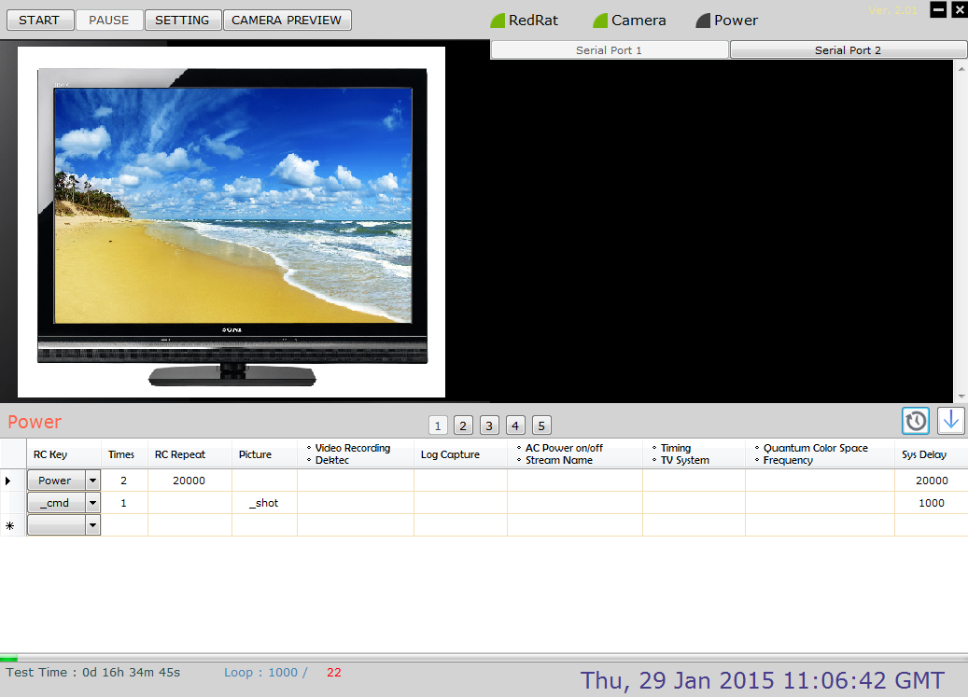
UI Introduction - Main Screen
Start / Pause stress test
Enter setting page
Preview camera video
Change Serial port
Camera
Video
Log
Data
Save as schedule file
Schedule
Command
Schedule RC key info
Switch Schedule

Slide 4
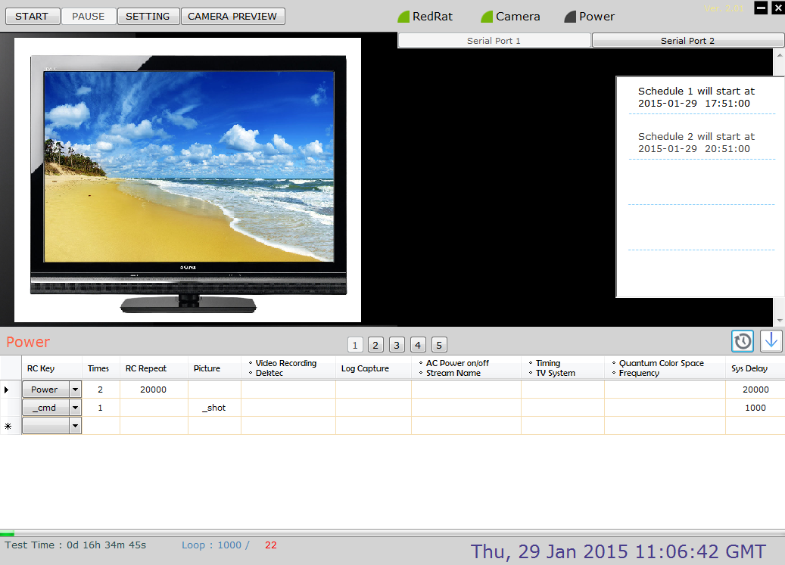
UI Introduction - Main Screen
Version info
IF you set Schedule Timer, schedule will auto to start,
user does not need to press [START ] button.
Schedule
Timer
Pop Schedule Timer list
drop-down list of RC key
Test time of schedule
Total loop / Current loop
Schedule progress bar

Slide 5
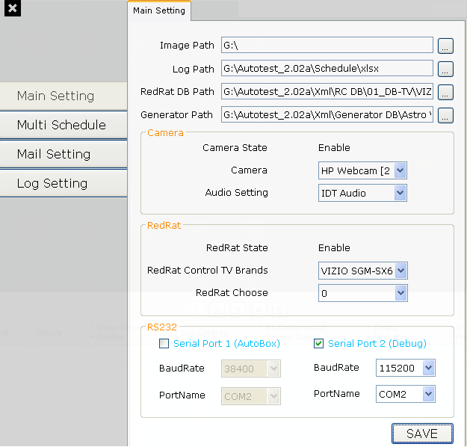
UI Introduction – Main Setting
Select location to save photo and log, load RC DB.
New feature:
User can add xml for Astro or Quantum .
Camera setting, select your camera device.
RedRat setting, select RedRat database.
Secord RS232 setting, select your comport and baudrate.
Press “SAVE” button to save date

Slide 6
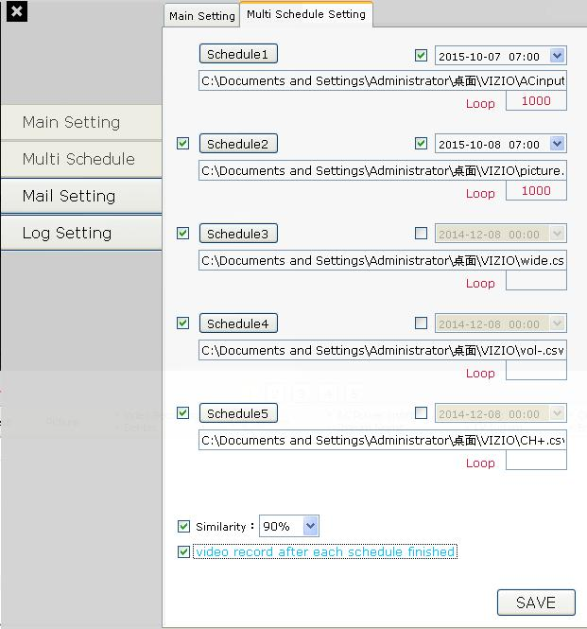
UI Introduction – Multi Schedule Setting
Press to load schedule file.
Start time of schedule.
Setting how many times to test for a schedule.
Enable or not to run schedule.
Similarity of Image Comparison.
Video record after each schedule finished.
Press “SAVE” button to save date.

Slide 7
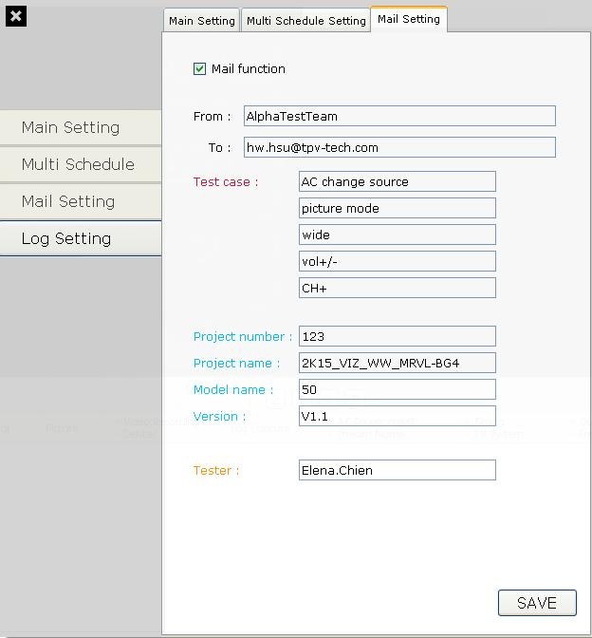
UI Introduction – Mail Setting
Enable or not to send mail after stress test finished.
If you enable it, [Form] and [To] must be filling in data.
Filling in information for mail.
Project number of URTracker.
Press “SAVE” button to save date

Slide 8
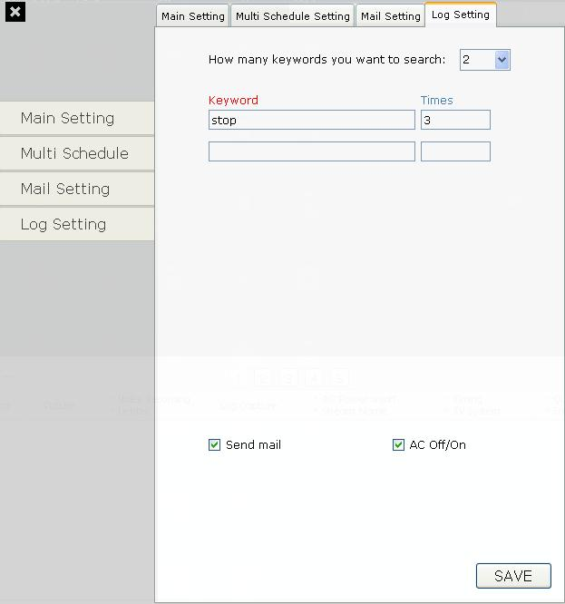
UI Introduction – Log Setting
New feature:
Set how many keywords you want to search.
New feature:
You can set the keyword that you want AutoTest to search in log.
New feature:
Set how many times that keyword you want to find.
New feature:
After the number of keywords be found, you can set AutoTest to do “Send mail” or “AC Off/On”.
Press “SAVE” button to save date

Slide 9
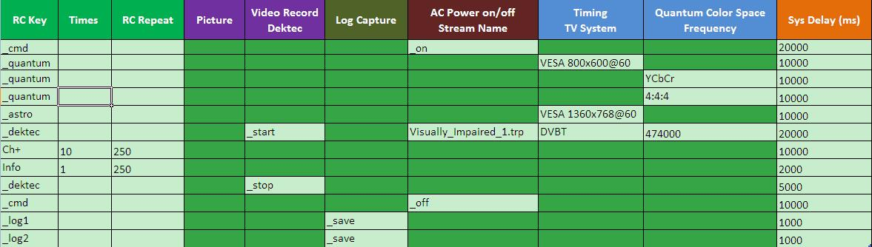
Schedule Example
System Setting :
Working folder setting
Input the schedule description
Execute by test times
Soft Remind:
Please use Script Template V2.01.xlsx to edit Schedule
If want use old Schedule, please transform new format

Slide 10
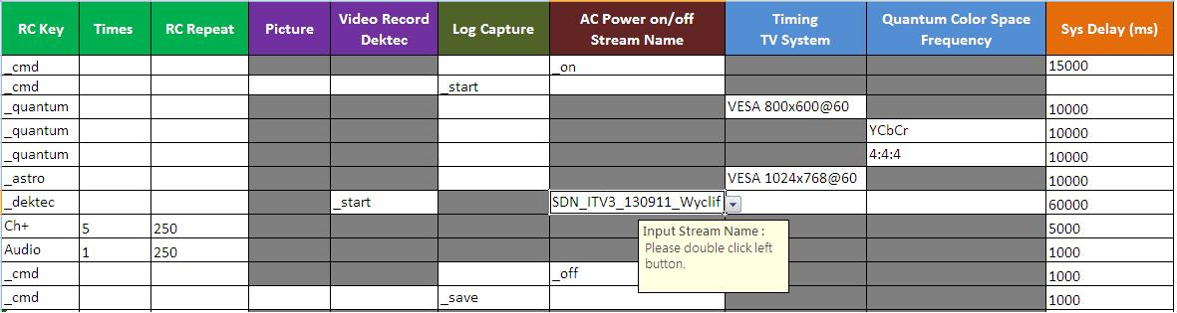
Define RC Key for Equipment Operation
Select RC key from pull-down list
“_quantum” or “_astro” is reserved for Auto Stress Test Equipment Control Command
Select Timing from pull-down list
Change color space for Quantum, can select from pull-down list
Define how many times this RC key is repeated
no repeat if empty
set stream to play, click twice can fill stream name
Define waiting duration before next RC key step
0 ms if empty

Slide 11
Define RC Key Operation
Select RC key from pull-down list
“_cmd” is reserved for Auto Stress Test System Control Command
Define waiting duration after each RC key sent
0 ms if empty
RC Key | Times | RC Repeat (ms) | … | Sys Delay (ms)
Menu | 1 |  | … | 300
Exit |  |  | …
Vol+ | 3 | 100 | … | 1000
Ch+ | 2 | 3000 | … | 300
Define how many times this RC key is repeated
no repeat if empty
Define waiting duration before next RC key step
0 ms if empty

Slide 12

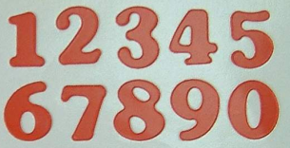
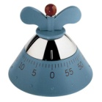
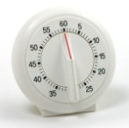





RC Key Operation Spec
RC Key | Times | RC Repeat (ms) | … | Sys Delay (ms)
Menu | 3 | 250 | … | 2000
NEXT RC
Menu
Menu
Menu

Slide 13
Define System Control Operation
“_cmd” is System, ”_log1; _log2” for COMport use, not RC key
Record Video/Audio
“_start”, “_stop”
System Power
“_on”, “_off”
Take a picture
“_shot”
Record RS232 message, by “_save”
Clear message by “_clear”
Except with “_” prefix, all text is sent to TV, “Enter” key is added automatically
Waiting time
0 ms if empty

Slide 14


Similarity Report Example
Similarity default setting = 90%
No. | Target | Source | Similarity | Sub-NG count | NG Rate | Result
1 | 1-1 | 2-1 | 80% | 1 | 1 | NG
2 | 1-2 | 2-2 | 90% | 0 | 0 | Pass
3 | 2-1 | 3-1 | 80% | 2 | 1 | NG
4 | 2-2 | 3-2 | 80% | 1 | 0.5 | NG
5 | 3-1 | 4-1 | 90% | 2 | 0.67 | Pass
6 | 3-2 | 4-2 | 90% | 1 | 0.33 | Pass
7 | 4-1 | 5-1 | 90% | 2 | 0.50 | Pass
8 | 4-2 | 5-2 | 90% | 1 | 0.25 | Pass
9 | 5-1 | 6-1 | 90% | 2 | 0.40 | Pass
10 | 5-2 | 6-2 | 90% | 1 | 0.20 | Pass
11 | 6-1 | 7-1 | 90% | 2 | 0.33 | Pass
12 | 6-2 | 7-2 | 90% | 1 | 0.17 | Pass
2nd loop compare
3rd loop compare
4th loop compare
5th loop compare
6th loop compare
7th loop compare
80%
90%
1-1
2-1
1-2
2-2
Target
Source
Target
Source
Target: Previous loop photo (click URL to pop image file)
Source: Current loop photo (click URL to pop image file)
Similarity: Target and source file to compare, similarity of Image Comparison.

Slide 15
Similarity Report Example
Similarity default setting = 90%
No. | Target | Source | Similarity | Sub-NG count | NG Rate | Result
1 | 1-1 | 2-1 | 80% | 1 | 1 | NG
2 | 1-2 | 2-2 | 90% | 0 | 0 | Pass
3 | 2-1 | 3-1 | 80% | 2 | 1 | NG
4 | 2-2 | 3-2 | 80% | 1 | 0.5 | NG
5 | 3-1 | 4-1 | 90% | 2 | 0.67 | Pass
6 | 3-2 | 4-2 | 90% | 1 | 0.33 | Pass
7 | 4-1 | 5-1 | 90% | 2 | 0.50 | Pass
8 | 4-2 | 5-2 | 90% | 1 | 0.25 | Pass
9 | 5-1 | 6-1 | 90% | 2 | 0.40 | Pass
10 | 5-2 | 6-2 | 90% | 1 | 0.20 | Pass
11 | 6-1 | 7-1 | 90% | 2 | 0.33 | Pass
12 | 6-2 | 7-2 | 90% | 1 | 0.17 | Pass
2nd loop compare
3rd loop compare
4th loop compare
5th loop compare
6th loop compare
7th loop compare
Sub-NG count: Count the number of NG result
Sub-NG count_3= Sub-NG count_1 + Sub-NG count_3
Sub-NG count_5= Sub-NG count_1 + Sub-NG count_3 + Sub-NG count_5
NG Rate: The rate of Sub-NG count and Sub grand total
NG Rate_5 = Sub-NG count_5 / count(1,3,5) = 2/3 = 0.67
Result: Result of Image Comparison

Slide 16
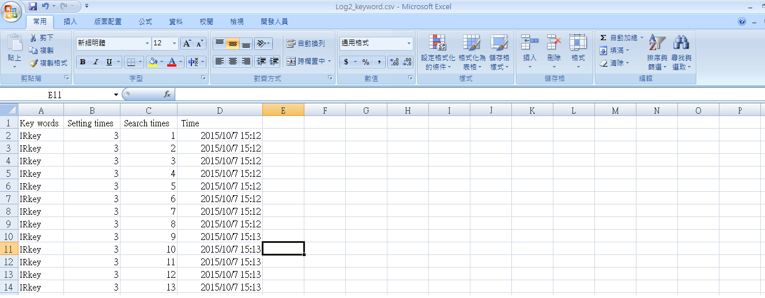
Log_Keyword.csv
※AutoTest will create a csv file on the path you set. Like this:
Show what time the keyword be found.

Slide 17
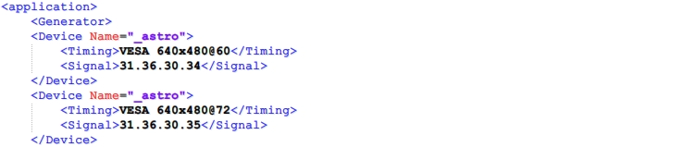
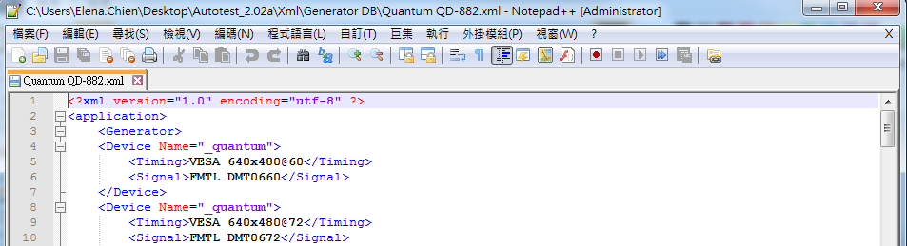
Edit the Astro & Quantum timing xml.
※ Open the Astro VG-872C.xml with Notepad++.exe
Edit the <Timing> and the <Signal> Format: 3X.3X.3X.3X
XXXX is the timing’s number in ASTRO
※ Open the Quantum QD-882.xml with Notepad++.exe
Edit the <Timing> and the <Signal>
Format: FMTLXXXX
XXXX is the timing’s number in Quantum

Slide 18
Trouble Shooting
Environment check:
File path/directory path are correctly set
Disable “Power saving” settings in PC/NB so that Auto Test won’t be affected by HD or peripheral power-down
I cannot find the RC key I need from pull-down list
Please report to RC database administrator
No Response on TV
Please make sure all indicators are correct
Please make sure RC protocol is set correctly
RC Key operation is lost occasionally
Duration of RC repeat and Sys delay should be sufficient for TV operation
The response time of TV is various over different RC and TV models
It is recommended to execute RC operation manually before setting RC repeat and Sys delay
Equipment connect to Auto box
ASTRO VG871-B/ VG872-C and Quantum 882/ Dektec Gold-215

Slide 19
Trouble Shooting
6. Multi Schedule:
Can set 5 schedules in stress test
Shorten the time
7. Mail system:
When test finish can send Mail to personnel
8. Time start:
If program enable Start time of schedule, please don’t press “ START ”button, program will automatic start on set time.

